Slide 1

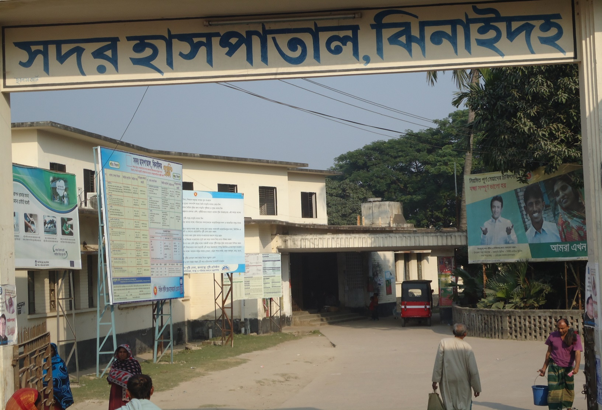
A problem solving process (KAIZEN) in EOC Word of
SADAR HOSPITAL, JHENAIDAH
Dr. Md. Emdadul Haque,
Senior Consultant (Obst & Gynae)

Slide 2

EOC Word

Slide 3
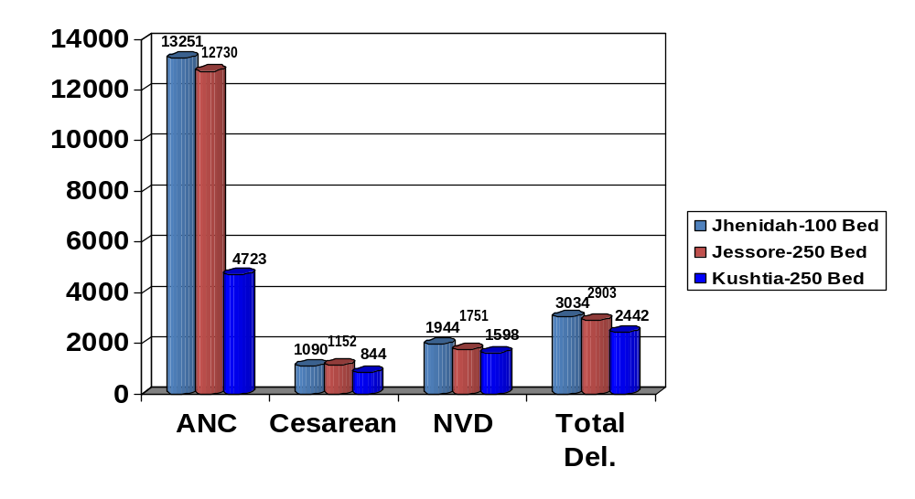
Comparative Data of EOC Service of 3 Best Performing District Hospital of Khulna Division in 2015

Slide 4
WIT 1 (EOC Word)
Team members:
1. Senior Consultant (Obst & Gynae)–Fascilitator
2. Word in charge (SSN) – Team leader
3. One SSN – Member secretary
4. One Ayah – Member
5. One Cleaner – Member

Slide 5
WIT: 1 (EOC Ward)
Step 1: Selection of Kaizen theme and feasibility check with Matrix Diagram
Possible KAIZEN Theme | Impact | Urgency | Possibility | Resources | Total Score
Implementation of partograph | 3 | 3 | 1 | 1 | 8
Improve infection prevention | 3 | 3 | 3 | 2 | 11
Improve ANC service with added component | 3 | 3 | 3 | 3 | 12
Improve post-operative care among the operated patient | 3 | 3 | 2 | 2 | 10
Improve display system of EOC service | 3 | 3 | 2 | 1 | 9
Maintain temperature chart for the patient of EOC ward. | 3 | 3 | 1 | 0 | 7

Slide 6
Step 2: Situation analysis
Kaizen theme: ANC service improved with comprehensive services components.
Data collection method: Data was collected by WIT members through exit interview of 30 women who would receive ANC service in consecutive 10 days from 5 to 15th August.
Sl No | Contributing factors | Frequency | Cumulative frequency | Cumulative %
1 | Proper fill up not done on ANC card | 24 | 24 | 30
2 | Per abdominal examination is not done properly | 21 | 45 | 56
3 | Estimation of HB% not done | 20 | 65 | 81
4 | Counseling not done | 9 | 74 | 93
5 | Medical officer/Consultant is not treated every case | 6 | 80 | 100

Slide 7
Step 3: Root cause analysis (Fishbone diagram):
a. Proper fill up of ANC card not done
Material
Man
No initiative for good quality
No initiative for medical officer
Supplied low quality machines
Lack of work distribution
Low quality Wt. machine
Limited Time
Proper fill up of ANC card not done
Wt. machine is not working properly
Overload of the patient
Privacy not maintained properly
Insufficient training
Lack of screening
SOP not prepared
Screen not supplied
Sop not available
Demand not given for screening
Lack of orientation
Environment
Method

Slide 8
b. Per abdominal examination is not done properly
Material
Man
No initiative for fund
Limited number of MO
Fund was not available
Lack of work distribution
Not supplied from the store
Limitation of time
Per abdominal examination is not done properly
Limited sitting arrangement
Overload of the patient
Privacy not maintained properly
Lack of proper knowledge
Lack of screening
Inadequate training
Screen not supplied
Lack of on-the-job training
Demand not given for screening
Lack of initiative of on-the-job training
Environment
Method

Slide 9
c. Estimation of HB% not done
Material
Man
Not taken initiative for good quality
Lack of initiative for manpower
Not supplied good quality
Shortage of manpower
Low quality Hemoglobinometer
Work distribution is not done
Estimation of HB% not done properly
Hemoglobinometer is not working properly
Overload of the patient
Delay for investigation
Lack of importance about hemoglobin estimation
Program not started in time
Lack of knowledge
Supervision not done properly
Health education not done properly
Initiative not taken for supervision
Initiative not taken
Environment
Method

Slide 10
Step 4: Identification of actions/countermeasures
Sl No | Root cause | Primary action | Secondary action | Importanc | Urgency | Difficulty | Time consumptio | Resource avaiability | Total score
1 | No initiative for medical officer | Arrangement of a female medical officer | Identify one medical officer | 2 | 3 | 2 | 2 | 1 | 10
 |  |  | Posting of a medical officer | 2 | 2 | 1 | 2 | 2 | 9
 |  |  | Identify place for sitting arrangement | 2 | 2 | 2 | 1 | 1 | 8
2 | No initiative for good quality weight machine | Arrangement of a good quality weight machine | Identify good quality weight machine | 3 | 3 | 2 | 2 | 2 | 12
 |  |  | Collection of weight machine | 3 | 3 | 2 | 2 | 2 | 12
 |  |  | Orientation about the use of weight machine | 3 | 3 | 3 | 2 | 3 | 14
3 | Lack of orientation for fill up of ANC card and abdominal examination | Organize a refresher training for fill up of ANC card and abdominal examination | Identify resource person | 3 | 3 | 2 | 3 | 3 | 14
 |  |  | Arrange logistic and module | 3 | 3 | 3 | 2 | 2 | 13
 |  |  | pre and post training arrangement | 3 | 3 | 3 | 3 | 3 | 15
4 | Demand not given for screening | Indenting of screen for privacy | Manage screen | 3 | 3 | 2 | 2 | 2 | 12
 |  |  | Select place for hanging screen | 3 | 3 | 3 | 2 | 3 | 14
 |  |  | Arrange logistics for hanging | 3 | 3 | 3 | 2 | 2 | 13
5 | No initiative of fund for sitting arrangement | Manage fund for sitting arrangement | Identify the required number of chairs | 3 | 2 | 2 | 2 | 2 | 11
 |  |  | Identify the probable cost of the chairs | 3 | 3 | 2 | 2 | 1 | 11
 |  |  | Identify the donors for the support | 3 | 3 | 1 | 1 | 1 | 9
6 | Lack of initiative for manpower for hemoglobin estimation | Arrange one MT lab manpower | Identify one MT lab | 3 | 3 | 1 | 1 | 1 | 9
 |  |  | Posting of an MT lab | 3 | 3 | 1 | 1 | 1 | 9
 |  |  | Identify place for sitting arrangement | 3 | 3 | 1 | 1 | 1 | 9
7 | Not taken initiative for good quality Hemoglobinometer | Indenting of good quality Hemoglobinometer | Identify specification of Hemoglobinometer | 3 | 3 | 2 | 1 | 1 | 10
 |  |  | Identify the handler person | 3 | 2 | 1 | 2 | 2 | 10
 |  |  | Orientation about the use of the equipment | 3 | 2 | 2 | 2 | 1 | 10
8 | Initiative not taken for supervision of hemoglobin estimation | Organize regular supervision system | Identify the person supervises regularly | 3 | 3 | 3 | 2 | 2 | 13
 |  |  | Make a checklist for quality investigation | 3 | 3 | 3 | 2 | 2 | 13
 |  |  | Ensure regular on-the-job training | 3 | 3 | 3 | 2 | 2 | 13
9 | Initiative not taken for health education | Arrange effective health education session | Identify the topics for health education | 3 | 3 | 3 | 2 | 2 | 13
 |  |  | Identify the health educator | 3 | 3 | 2 | 2 | 2 | 12
 |  |  | Regular monitoring of health education | 3 | 3 | 2 | 2 | 2 | 12

Slide 11
Step 5: Implementation of actions/countermeasures: action plan and progress monitoring for EOC ward (WIT-1)
Sl | Actions | Where | Who | When | Date of monitoring | Who will monitor | Progress
1 | Identify good quality weight machine | EOC ward | Consultant | 20 to 30 Aug | 28 Aug | RMO
2 | Collection of weight machine | EOC ward | Hospital Super | 30 Aug to 15 Sept | 10 Sept | Super
3 | Orientation about the use of weight machine | EOC ward | Consultant | 15 to 20 Sept | 18 Sept | Focal Person
4 | Identify resource person | EOC ward | Consultant | 20 to 30 Aug | 25 Aug | Focal Person
5 | Arrange logistic and module | EOC ward | RMO | 20 Aug to 10 Sept | 5 Sept | Focal Person
6 | pre and post training arrangement | EOC ward | Consultant | 25 Aug to 5 Sept | 30 Aug | RMO
7 | Manage screen | EOC ward | Store keeper | 25 Aug to 15 Sept | 30 Aug | RMO
8 | Select place for hanging screen | EOC ward | Team Leader | 15 Sept to 20 Sept | 17 Sept | Focal Person
9 | Arrange logistics for hanging | EOC ward | Team Leader | 15 Sept to 20 Sept | 17 Sept | Focal Person
10 | Identify the person supervises regularly | EOC ward | RMO | 25 to 30 Aug | 28 Aug | Super
11 | Make a checklist for quality investigation | EOC ward | RMO | 25 Aug to 10 Sept | 5 Sept | Super
12 | Ensure regular on-the-job training | EOC ward | Hospital Super | 30 Aug to 15 Sept | 10 Sept | Super
13 | Identify the topics for health education | EOC ward | Consultant | 25 Aug to 30 Aug | 28 Aug | Focal Person
14 | Identify the health educator | EOC ward | RMO | 25 Aug to 30 Aug | 27 Aug | Super
15 | Regular monitoring of health education | EOC ward | Hospital Super | 1 to 30 Sept | 15 Sept | Super

Slide 12
Check Effectiveness of action
Necessary Data is collected for effectiveness. Check if it is the same methodology and period applied in step 2.
Compare the table for effectiveness, check if it is developed or not.
Pareto Chart before and after KAIZEN are developed based on the comparison table or not.

Slide 13
Standardization of effective counter measures:
Before KAIZEN After KAIZEN

Slide 14

Thank You
Notes:
14

